Slide 1
WEEK 3 : MODEL SELECTION, TRAINING, HYPERPARAMETER TUNING, MODEL EVALUATION
ISHAN BORKER

Slide 2
CONTENTS
Model Training
Hyperparameter tuning
Decision Tree Classifier
Random Forest Classifier
XGBoost Classifier
Gradient Boosting Classifier
Logistic Regression
Voting Classifier
GridSearch CV
Randomized Search CV
Model Selection
Train-Test-Valid Split
Cross-Validation (CV)
Bootstrapping
Model Performance Evaluation
Exporting the ML Model
Calculating the performance Metrics like accuracy, precision, recall, f1-score
Loading the trained models using joblib

Slide 3
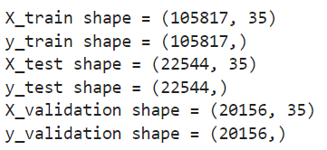
Model Selection
Train – Test – Valid Split:
Training data → Set of the data on which the actual training takes place
Validation Set → helps to improve the model performance by fine-tuning the model after each epoch
Test set → informs us about the final accuracy of the model after completing the training phase
The train test validation split is a technique for partitioning data into training, validation, and test sets
train data is split into train and validation in the ratio of 84:16

Slide 4
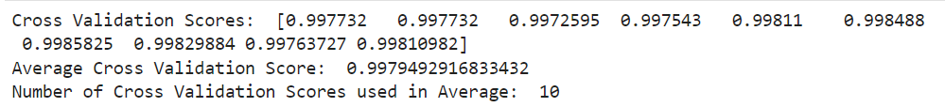
Cross-Validation (CV):
Used to test trained machine-learning models and to evaluate their performance independently
K-Fold CV:
The training data used in the model is split into k number of smaller sets for validating the model
The model is then trained on k-1 folds of training set
The remaining fold is then used as a validation set to evaluate the model
Use estimator as decision tree classifier, and we split K-fold into n=10
Compute the cross-validation score using cross_val_score to get average cross validation score and the number of cross validations used

Slide 5
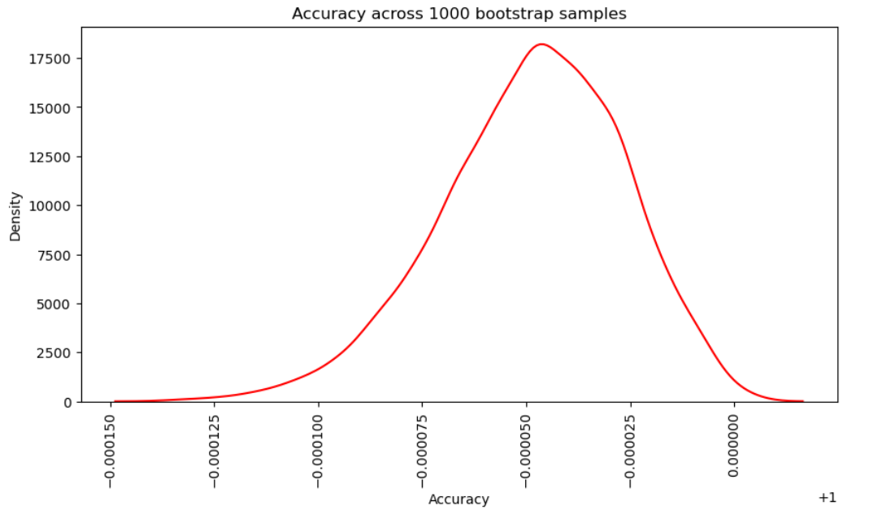
Bootstrapping:
Resampling technique that helps in estimating the uncertainty of a statistical model
Includes sampling the original dataset with replacement and generating multiple new datasets of the same size as the original

Slide 6
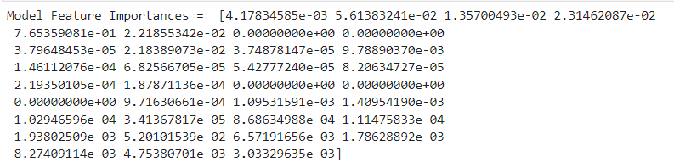
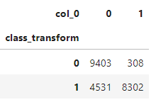
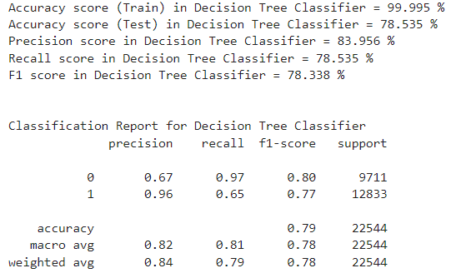
Model Training
Decision Tree Classifier
Confusion Matrix
Model Feature Importance
Performance Metrics

Slide 7
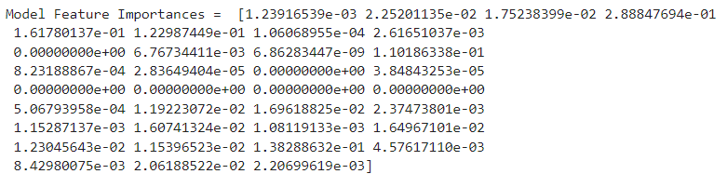
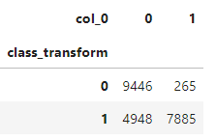
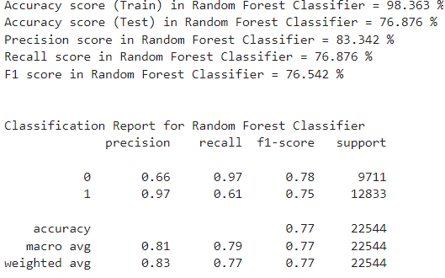
Random Forest Classifier
Model Feature Importance
Confusion Matrix
Performance Metrics

Slide 8
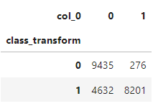
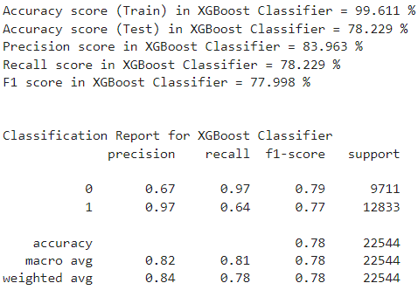
XGBoost Classifier
Confusion Matrix
Performance Metrics

Slide 9
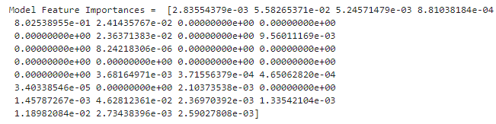
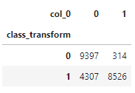
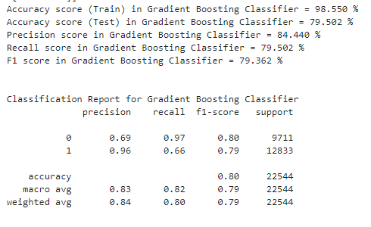
Gradient Boosting Classifier:
Model Feature Importance
Confusion Matrix
Performance Metrics

Slide 10
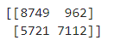
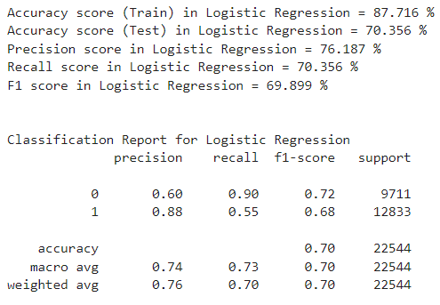
Logistic Regression
Confusion Matrix
Performance Metrics

Slide 11
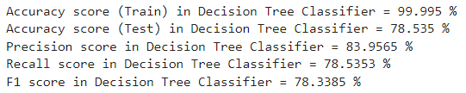
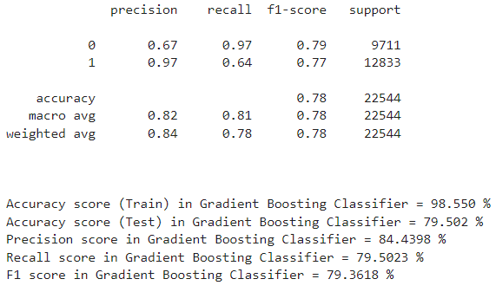
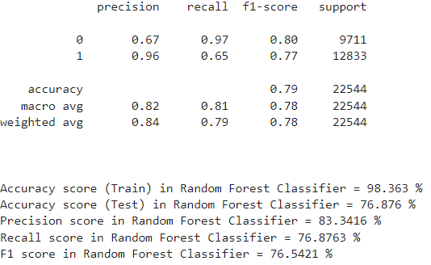
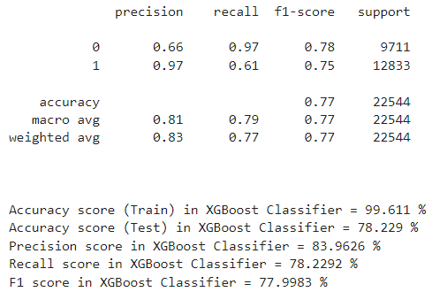
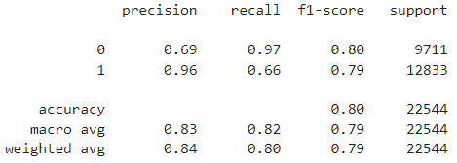
Voting Classifier

Slide 12
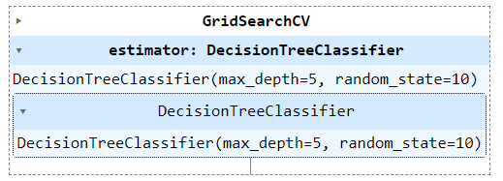
Hyperparameter Tuning
Process of finding the right combination of hyperparameter values to achieve maximum performance on the data in a reasonable amount of time
GridSearch CV
Process of performing hyperparameter tuning in order to determine the optimal values for a given model
Tries all the combinations of the values passed in the dictionary and evaluates the model for each combination using the Cross-Validation method

Slide 13
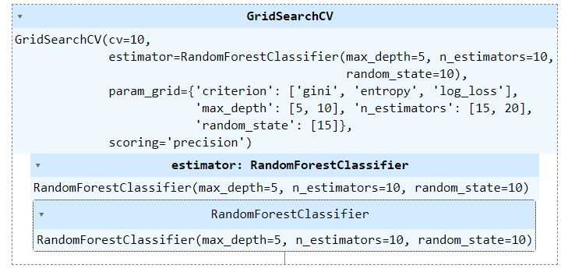

Slide 14
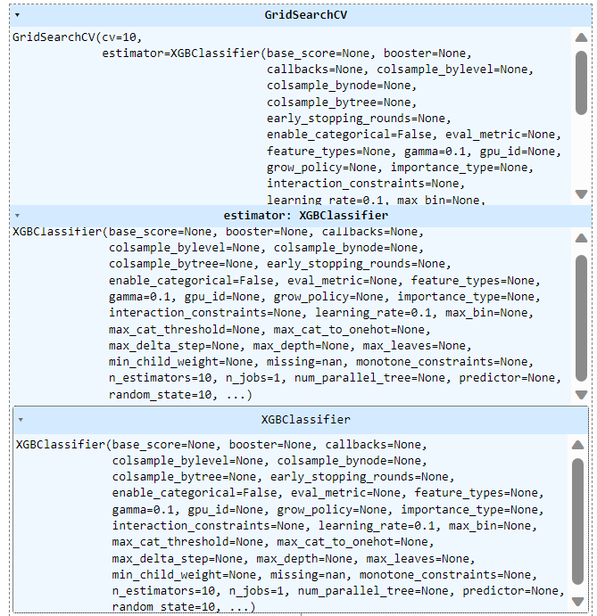

Slide 15
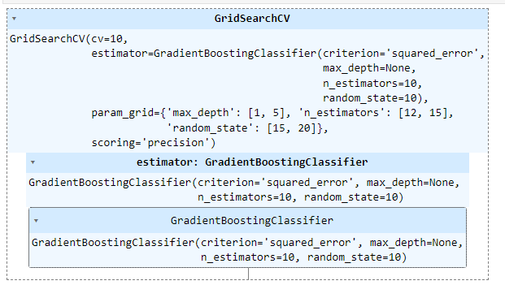
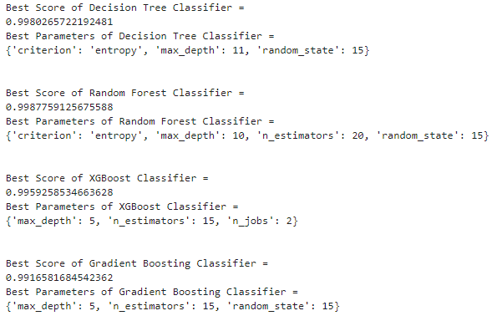

Slide 16
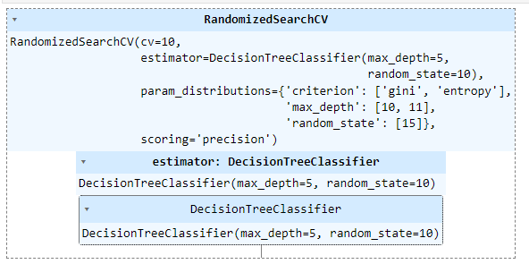
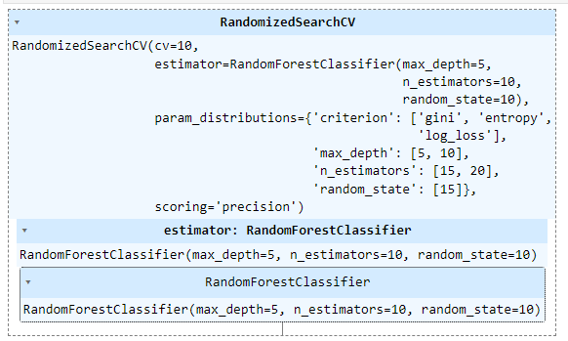
RandomizedSearch CV

Slide 17
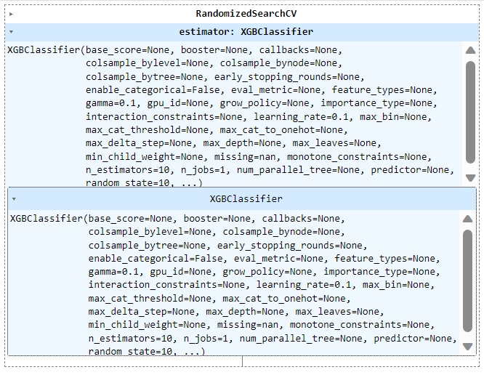
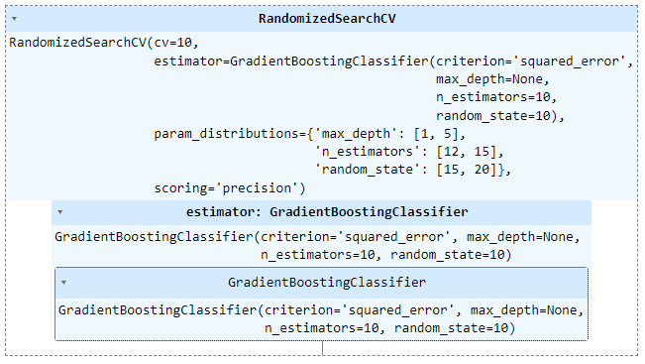

Slide 18
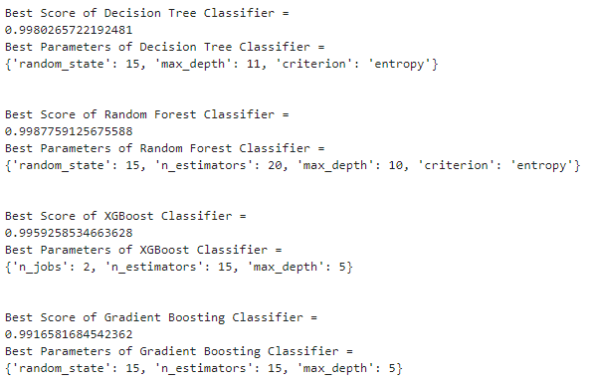
Results of Voting Classifier

Slide 19
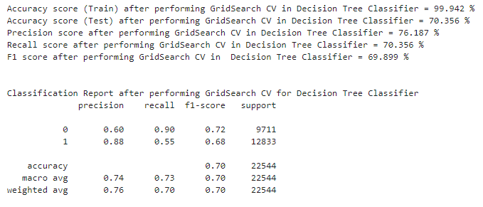
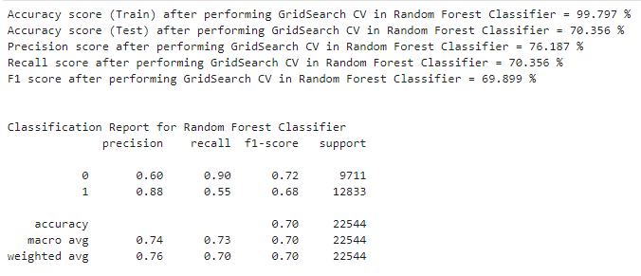
Model Performance Evaluation
Results using GridSearch CV

Slide 20
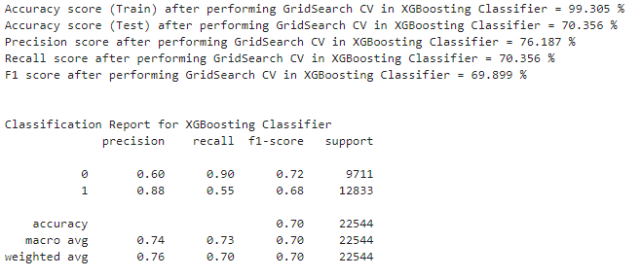
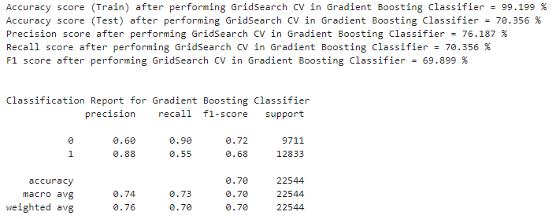

Slide 21
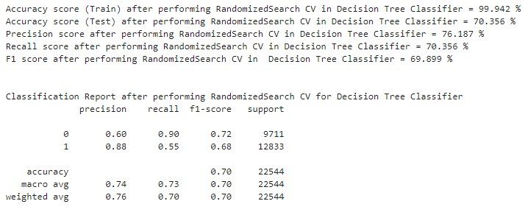
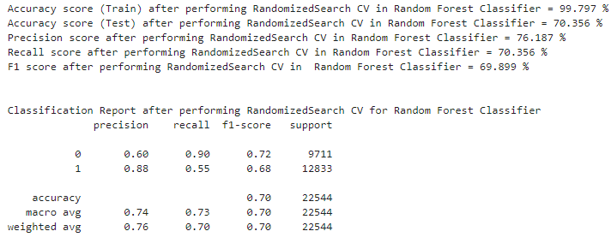
Results using RandomizedSearch CV

Slide 22
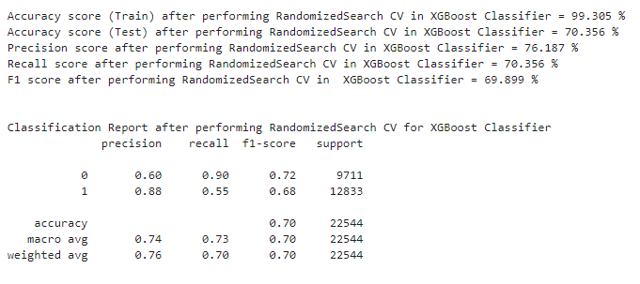
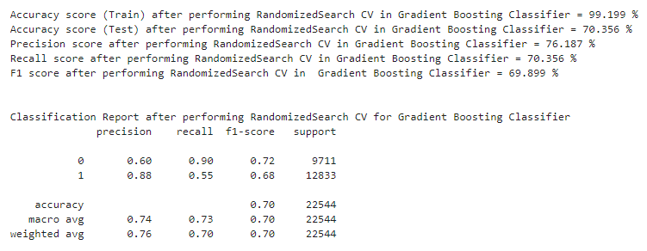

Slide 23
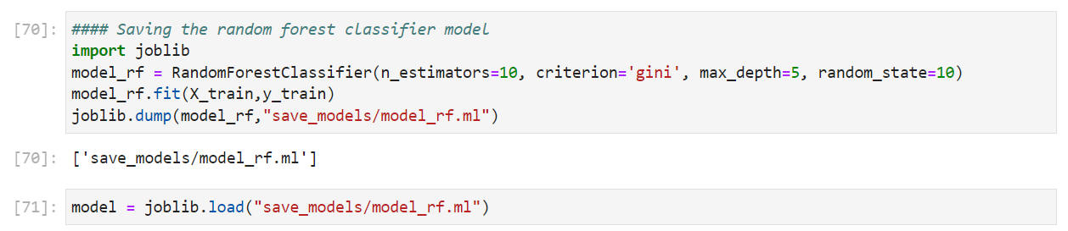
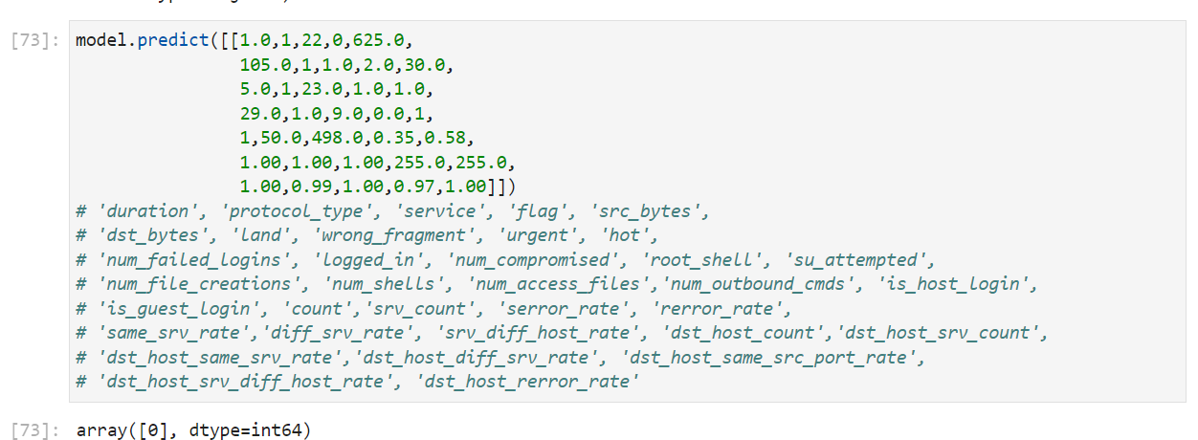
Exporting the Trained Machine Learning Model
It’s done to serve the predictions from the AI platform prediction
Joblib – python library to run computationally intensive tasks in parallel
Save the model and resume the execution later on different systems
Results using Random Forest:

Slide 24
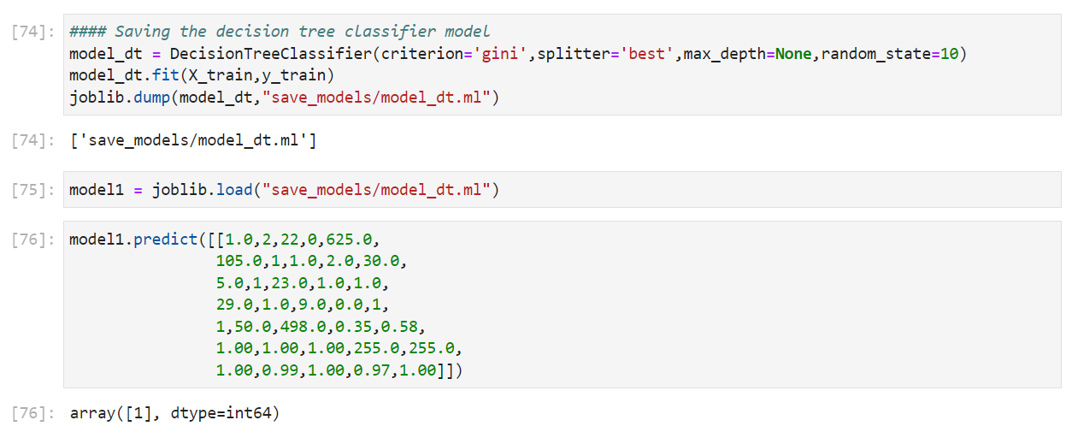
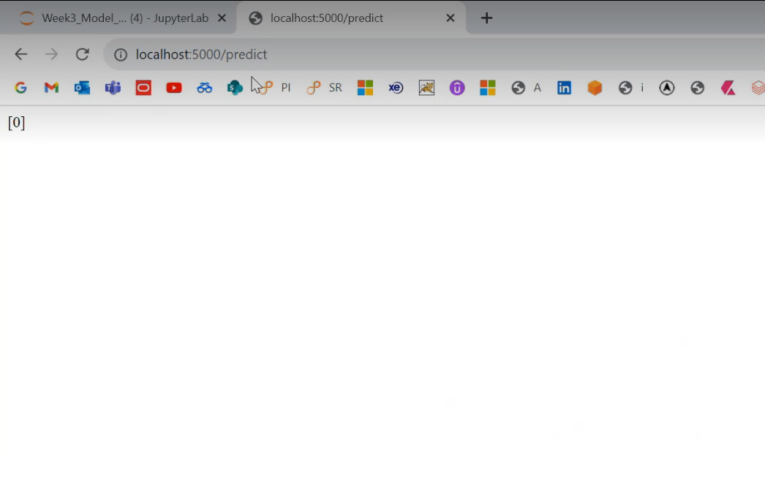
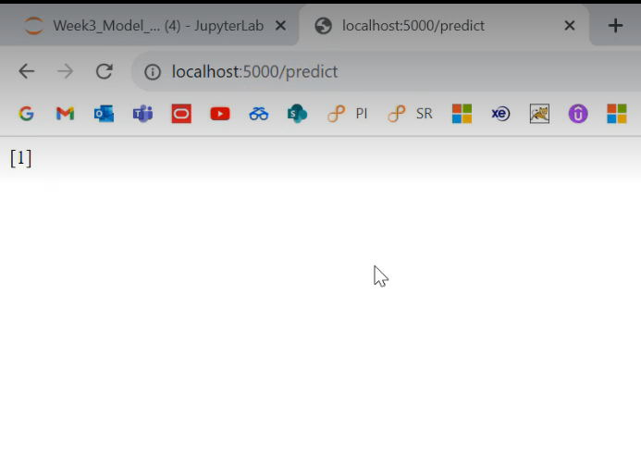
Results using Decision Tree Classifier
Using Flask API these models were then hosted on the server
Random Forest Classifier
Decision Tree Classifier

Slide 25



